Slide 1
Airpods Clear
By Wesley, Abhi, Jonathon, Josh, Aidan

Slide 2
Marketing Presentation Roles & Responsibilities
Target Audience Analysis by Abhi
Product Adjustment by Abhi
Pricing Strategy by Wesley
Promotion Strategy by Wesley
Place/Distribution by Aidan
AI Generated Mockups by Jonathan
Strategy Justification by Josh

Slide 3

Target Audience Analysis
Demographics
Psychographics
Behavioural Traits
Key Points/Pain Points
Target Market Persona

Slide 4
Demographics
Age Group: Adults ages 55–85, all genders
Income Level: Middle-class, practical spenders
Level of Education: High-school education level
Stage of Life: In the grandparent stage of life
Preference: Prefer reliable products that make daily life easier

Slide 5
Psychographics
Live active, engaged lifestyles
Enjoy family time and family-oriented activities
Curious and open to new technology
Value convenience, simplicity, and staying connected
Motivated by tools that enhance everyday enjoyment

Slide 6
Behavioural Traits
Frequent device users throughout the day
Show strong loyalty once they trust a brand
Use technology to stay connected, informed, and entertained
Seek improved communication with loved ones
Prefer seamless, intuitive product experiences

Slide 7

Key Points/Pain Points
Need
Need more accessible, easy-to-use communication tools
Struggle
Struggle with technology that hasn’t adapted to their needs
Want
Want clearer, simpler ways to connect with family
Desire
Desire conveniences that fit naturally into routines
Seek
Seek solutions that reduce frustration and boost confidence

Slide 8
Target Market Persona
A 55–85-year-old who values staying close to family
Not highly tech-savvy but willing to learn if it improves communication
Prefers tools that are simple, comfortable, and reliable
Wants to feel included, supported, and connected no matter the distance

Slide 9
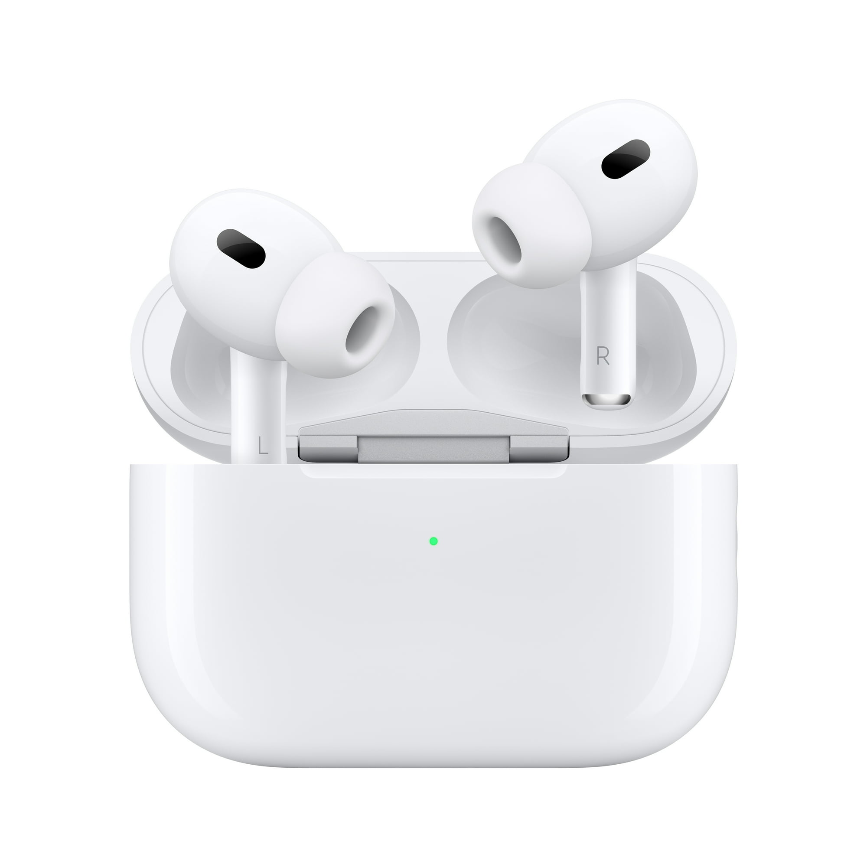
Product Adjustment
Core Product
Actual Product
Augmented Product
Branding & Packaging

Slide 10
Core Product
Makes AirPods easier and more comfortable for older adults
Provides better audio augmentation for clearer listening
Offers simple, stress-free features designed for accessibility
Helps users stay connected effortlessly with family and daily life

Slide 11
Actual Product
Smarter sound tuning for clearer voices and personalized hearing
Easy voice and touch controls for simple daily use
Seamless multi-device connection with no setup confusion
Sleek, minimal design optimized for all-day comfort
Longer battery life, faster charging, and more stable connectivity
Maintains the trusted AirPods quality with enhanced usability

Slide 12
Augmented Product
Extended warranty for additional protection
Free trial period to build confidence and trust
24/7 support with remote setup assistance
Companion app for personalized sound settings
Regular software updates adding new features and improvements

Slide 13
Branding & Packaging
Minimal, elegant logo aligned with the AirPods aesthetic
White and soft neutrals with subtle metallic accents
Simple, eco-friendly packaging
Gentle, calming tones that feel modern and inviting
Overall design communicates comfort, quality, and ease-of-use

Slide 14

Pricing Strategy
Pricing Objective: Affordable, but Still Premium
1. Affordability (Primary Goal)
Create a clear sense of value for older buyers
Use simple, transparent pricing
Reduce hesitation around adopting new technology
Occasional promotions to increase comfort with purchase
2. Maintain a Premium Image (Secondary Goal)
Leverage Apple’s trusted brand reputation
Highlight quality, ease of use, and reliability
Differentiate from low-cost/low-quality alternatives
Reinforce that “paying a little more” delivers significantly higher value

Slide 15

Perceived Value
Perceived Value & Value Proposition
Why AirPods Are a Great Deal for Our Target Audience:
Simple & Easy to Use: Seamless pairing and intuitive controls reduce frustration and make every day tech feel manageable.
Improves Daily Life: Enhances phone calls, video chats, walking, TV watching, and other routine activities.
Comfortable & Reliable: Clear sound, comfortable fit, and stable performance support confident, independent use.
Works With Devices They Already Own: No complicated setup or extra accessories needed.
Trusted Apple Quality: Durable, dependable, and backed by a reputable brand—feels like a smart, long-lasting investment.
Enhances Connection & Independence: Helps older adults stay in touch with loved ones while increasing convenience and quality of life.

Slide 16
Tiered Pricing Strategy
Why Tiered & Psychological Pricing Work for This Audience
Tiered Pricing:
Provides clear, simple choices at different price points
Lets older buyers pick the option that best fits their needs and budget
Reduces overwhelm by offering structured, easy-to-compare options
Psychological Pricing
Makes the purchase feel more approachable (e.g., “$199” instead of “$200”)
Uses familiar pricing cues that communicate value without pressure
Simple value framing (“clear calls, all-day comfort, long-lasting quality”) reinforces confidence in the purchase

Slide 17
Price Sensitivity and Product Sensitivity
Price and Product Sensitivity of Adults Ages 55–85
Moderate Price Sensitivity: Many are on fixed or carefully managed incomes, leading to cautious decision-making.
Careful With New Tech: They evaluate unfamiliar technology more slowly and look for reassurance before buying.
Willing to Pay More for Meaningful Benefits: If a product improves daily life or strengthens connection with loved ones, higher prices feel justified.
Trust Matters: Well-known, reliable brands reduce perceived risk and make the price feel safer and more reasonable.
Lower Sensitivity With Clear Value: Simplicity, comfort, and long-term durability increase confidence in the investment.
Value Messaging Works Best: Highlighting usefulness and longevity is more effective than discount-heavy promotions.

Slide 18
Core Message
Core Message: Easy, Comfortable, and Connected
AirPods make staying connected with family simple, comfortable, and stress-free.
Designed for older adults who want modern technology without the frustration.
Easy to use, easy to access, and easy to enjoy—helping them stay in the loop with the people who matter most.
Our goal: Make modern communication feel effortless, not overwhelming.

Slide 19
AIDA Plan A
Attention
Break the perception that AirPods are only for younger generations.
Highlight ease of use, comfort, and clear sound right from the start.
Use welcoming, relatable messaging that instantly feels accessible to older adults.

Slide 20
AIDA Plan I
Interest
Show how AirPods simplify everyday life for older adults.
Emphasize automatic connection to TVs, phones, and other devices to reduce frustration.
Highlight that once paired, they stay connected—eliminating repeated setup and improving overall ease of use.

Slide 21
AIDA Plan D
Desire
Build emotional appeal by highlighting independence and confidence in using modern technology.
Show how AirPods make it easier to stay connected with family and friends, reducing worry for loved ones.
Emphasize the comfort, reliability, and freedom that come from effortless communication.

Slide 22
AIDA Plan A (Again)
Action
Make purchasing feel simple, safe, and unintimidating for older adults.
Offer in-store demonstrations and on-site device pairing to support confident setup.
Provide senior-friendly policies: longer return windows, dedicated phone support, and a clear, easy “Getting Started Guide” included in the box.

Slide 23
Promotion Mix
Promotional Mix Strategy (Single Slide)
Advertising:
Use trusted print newsletters, plus TV and radio—familiar channels that effectively reach older adults.
Sales Promotion:
Offer in-store demos to show ease of use, comfort, and simple setup, allowing hands-on experience.
Public Relations:
Partner with senior living centers and retirement communities to demonstrate AirPods and gather feedback.
Digital & Social Media:
Focus on Facebook campaigns with short demo videos (pairing, charging, call clarity, transparency mode).
Personal Selling:
Train staff to be patient and supportive; provide one-on-one setup sessions for customers needing extra help.

Slide 24
Channels of Distribution
Top 3 Marketing Outlets
1. Television
Still the #1 media source for adults 55+.
Ideal placements: morning news, early evening news, and health/wellness segments.
Reaches this audience in a familiar, trusted environment.
2. Facebook
Most-used social platform for this demographic.
Fits naturally with their goal of staying connected with family.
AirPods enhance communication, making the message feel relevant and integrated into daily life.
3. Brick-and-Mortar Stores
Provides hands-on demos and guided assistance.
Allows older adults to experience ease of use and comfort firsthand.
Requires patient, well-trained staff to support setup and build confidence with new technology.

Slide 25

Distribution Strategy
Locations:
Supercentres, such as Walmart and Target.
Tech stores, such as Best Buy.
Online storefronts, including both Apple's site and other storefronts.
Apple stores.

Slide 26
Distribution Strategy
Distribution Intensity:
Intensive distribution intensity.
Want our product to be in front of as many eyes as possible.
Convenience for Audience:
Same locations as where our customers are already buying things, especially in the supercenters.
Can grab their attention whilst doing everyday shopping.

Slide 27
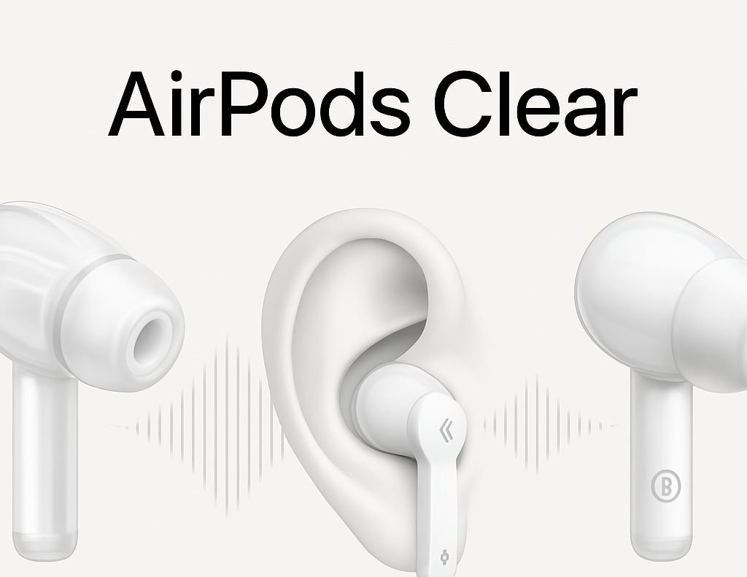
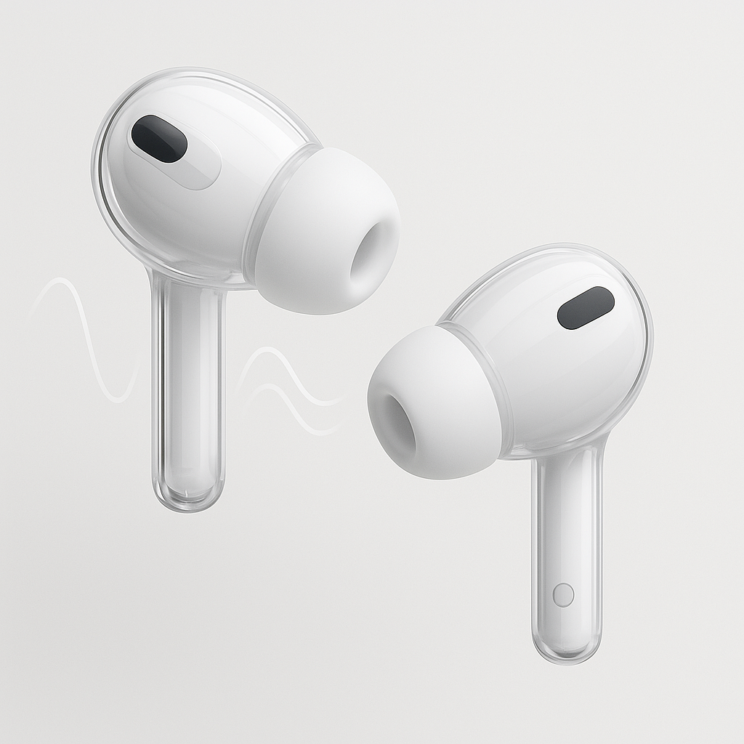
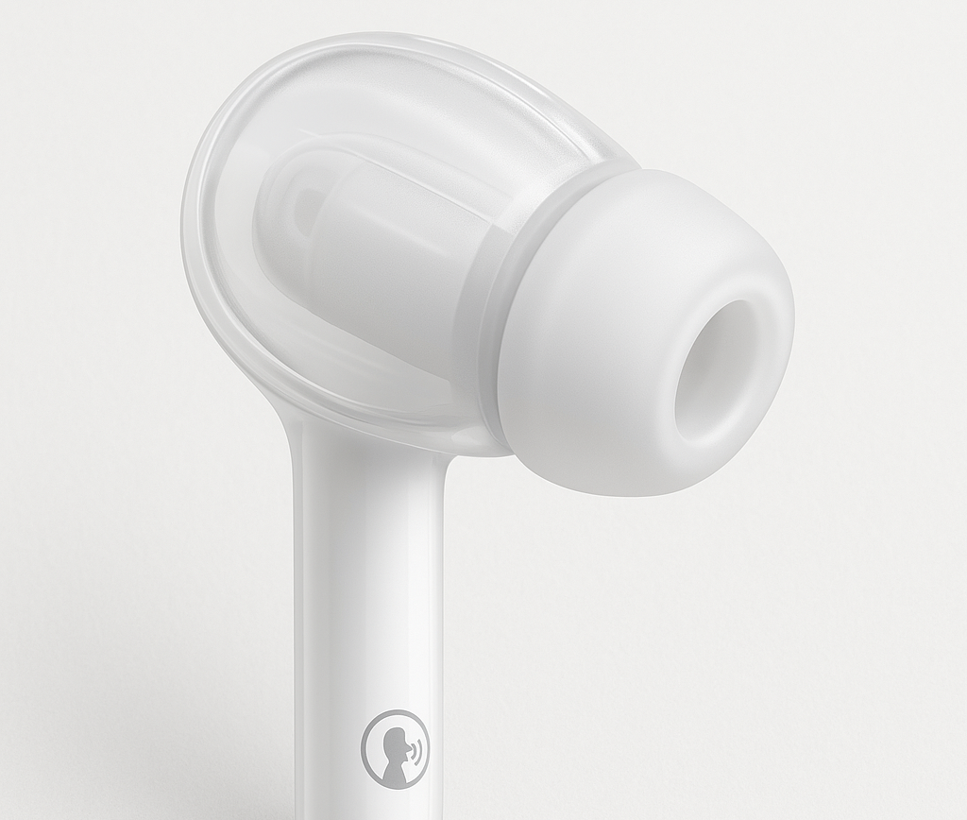
Product Only Mock-up
Displayed from multiple angles including in-ear view.
Neutral White/soft Gray background with soft shadows
Ergonomic redesign: extended stem + larger silicone tip for comfort.
Subtle icons near stem for voice/touch Icons near stem for voice/touch controls
Faint soundwave graphic signals for smarter sound tuning
This matters for our target because we are This matters for our ta
We reinforce our premium Apple identity-simple, modern and trustworthy

Slide 28
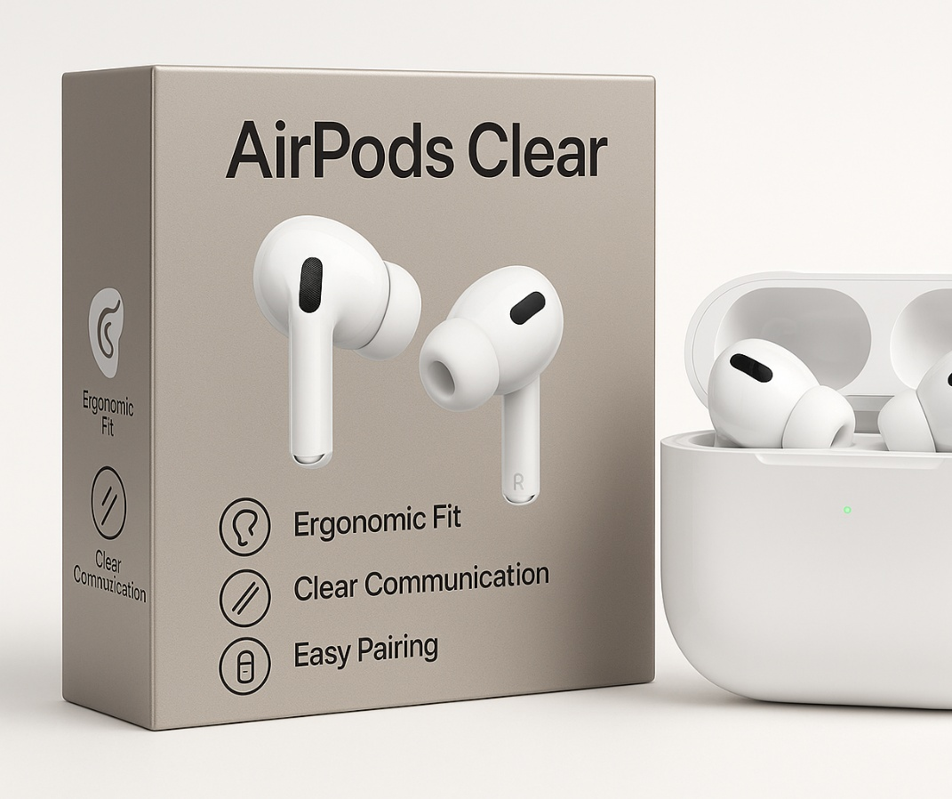
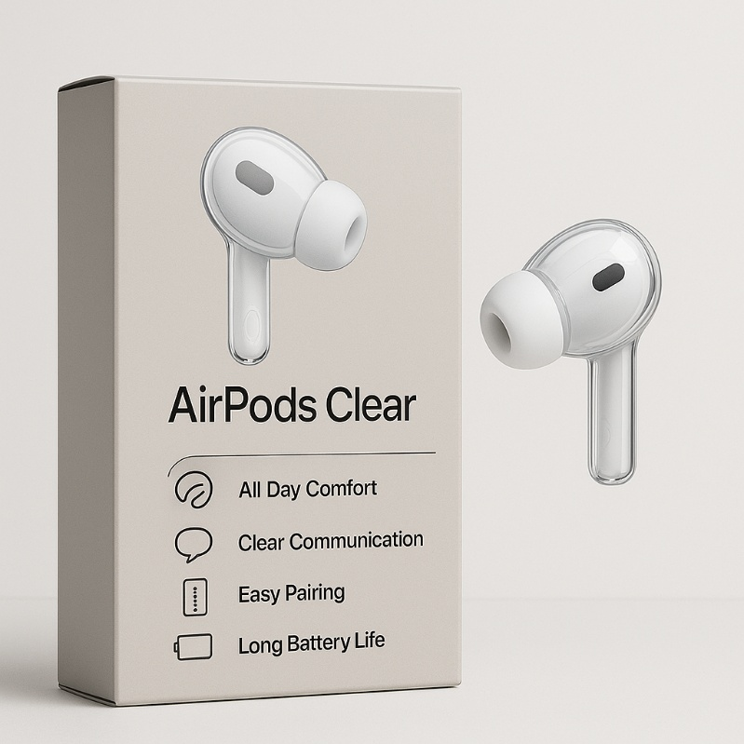
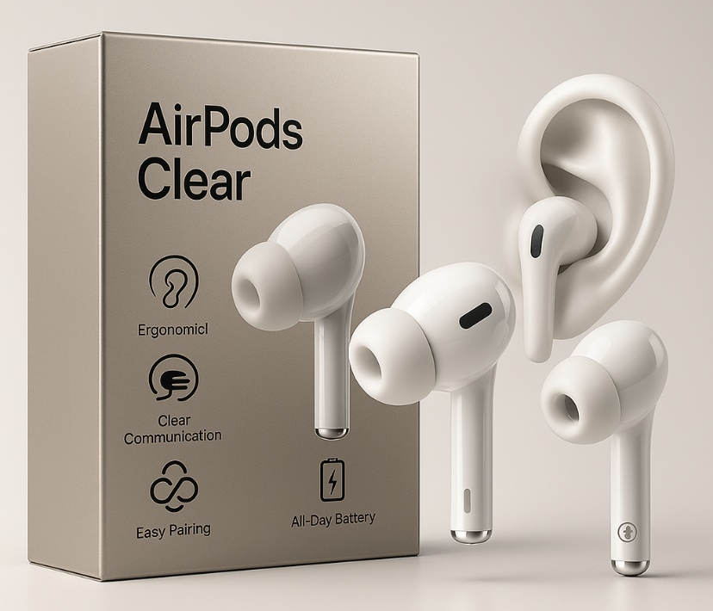
Product Packaging Mockup
Front Packaging
-Packaging is in a warm gray with subtle metallic accents.
-Large font, bolded for readability.
-Front features “ AirPods Clear “ Branding with contrast labeling.
Back of Package
-Four large icons with short descriptions; Ergonomic fit, Clear Communication, Easy Pairing, All-Day Battery.
-Clean Spacing to Reduce cognitive load.

Slide 29


Visual Mockup: Advertisements
Goal: Show emotional benefits i.e. staying connected with family.
How we show it: Grandparent wearing Air pods Clear on a video call with grandchild in a warm home setting with soft lighting and friendly colors.
Ad would deliver messages such as our headline, “Stay Connected. Stay Clear. “ with our subline “ Designed for family, comfort and everyday life.”
Builds trust comfort and familiarity for older adults, focuses on clarity and simplicity while grabbing attention and motivating actions.

Slide 30
Strategic Justification
AirPods Clear are simple, comfortable wireless earbuds designed specifically for older adults.
They make staying connected to family easy and stress-free by offering clear sound, intuitive controls, and trusted Apple reliability,
all at an attainable price.

Slide 31
How Our 4Ps Work Together
Making Technology Easy, Comfortable, and Trustworthy for Adults 55–85
Product
Reduces frustration and makes everyday use feel natural.
Price
Uses tiered and psychological pricing to keep the product accessible while maintaining Apple’s premium quality.
Promotion
Clear, reassuring messages about staying connected with family—delivered through TV, Facebook, print, and in-store demos.
Place
Stress-free buying in familiar locations like Walmart, Best Buy, and Apple Stores, with staff ready to help with setup and questions.

Slide 32
SWOT Analysis: Building Our Strategy
Our strategy leverages strengths, opportunities, and addresses weaknesses and threats to serve adults 55–85.
Strengths
Apple’s strong brand equity and trust
High sound quality and reliable hardware
Seamless integration with iPhones, iPads, and Apple TV
Longevity and durability that inspire confidence
Weaknesses
Standard AirPods can feel confusing or intimidating
Small size and subtle touch controls may be harder for older adults to see or operate
Opportunities
Growing 55–85 population using digital tools for video calls, telehealth, and streaming
Market gap for senior-friendly, easy-to-use tech focused on communication and comfort
Threats
Cheaper wireless earbud competitors
Hearing-aid-style devices targeting similar audience
Resistance to adopting new tech if perceived as complicated or risky

Slide 33
Why This Strategy Works
Removes barriers: confusing setup, tiny controls, fear of “breaking” tech
Built for How Older Adults Think, Feel, and Shop:
Supports what matters most: family connection, independence, trust in durability
Combines Apple’s brand reputation with senior-friendly features, fair pricing, and promotions in channels they already use
Replaces them with: clear sound, simple design, patient support, familiar buying locations

Slide 34
Thank You!

